Slide 1




Population genetics and data analysis in R programming language
Dr. Shankar Kaji Shakya
https://shankarkshakya.github.io/
Botany and Plant Pathology
Oregon State University, USA

Slide 2

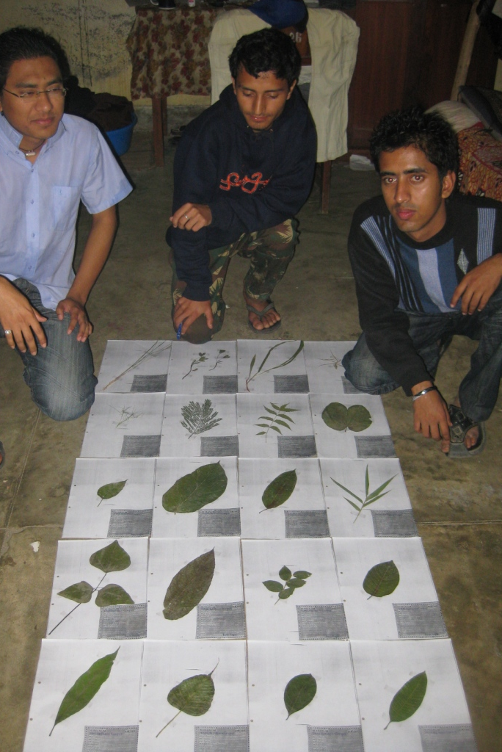

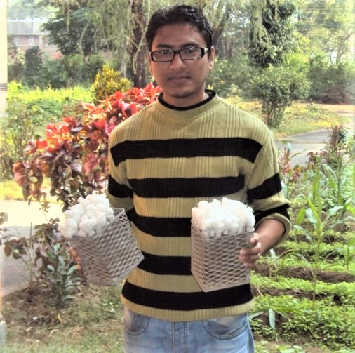
B.S. Plant Pathology
Tribhuwan University, Nepal (2006-2010)

Slide 3

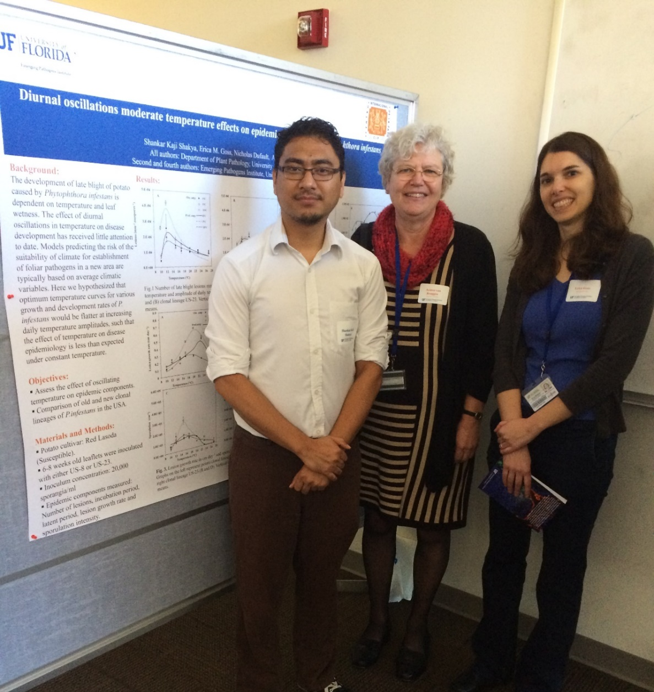
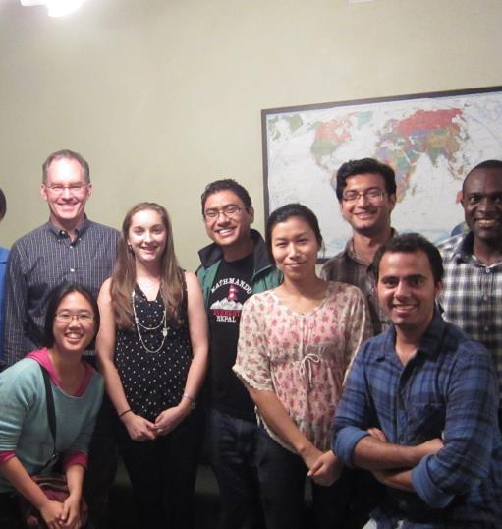
M.S. Plant Pathology
University of Florida (2012-2014)

Slide 4
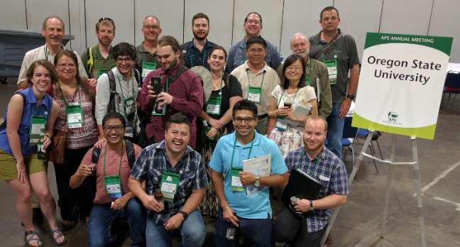

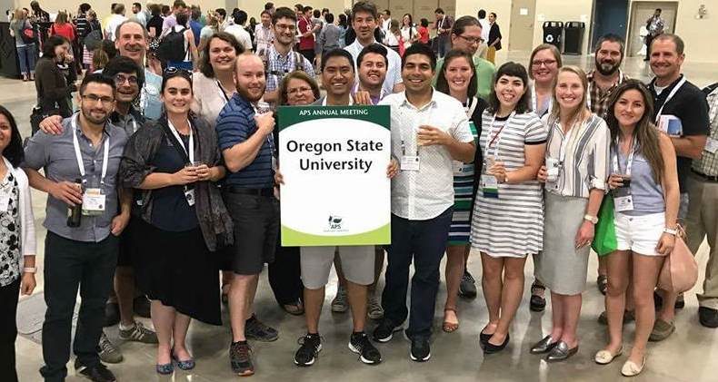
Ph.D. 2019
Oregon State University

Slide 5
Information about workshop
This will be a 2.5-3 day workshop
Each day 10 am - 3 pm with appropriate breaks
We will learn 3 important things/areas in this workshop
What is population genetics?
What is R and R programming?
How to analyze population genetics data in R?
Be respectful

Slide 6
Overall outline:
Day 1: Lecture on introduction to population genetics, Hardy Weinberg equilibrium, microsatellite markers, population structure and clustering, neighbor joining tree.
Day 2: R and Rstudio, data analysis in R and plotting.
Day 3: Microsatellite data analysis in R (Shakya et al. 2018) and certificate distribution

Slide 7
Now lets make a group of 4 people

Slide 8
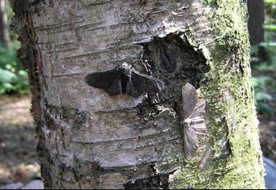
Day 1 : Intro to population genetics
Study of genetic composition of the population and forces that cause changes in this composition. Simply, it is also the study of forces like mutation, migration, selection and drift. Before diving into details, there are some key concepts that we need to learn.
Example of natural selection: Peppered moth
Two forms of peppered moth: Black and white
Black ones were easy to spot by predators: until 1848 white were prevalent
But after industrial revolution trees were blackened and black forms were prevalent but white forms were lost

Slide 9
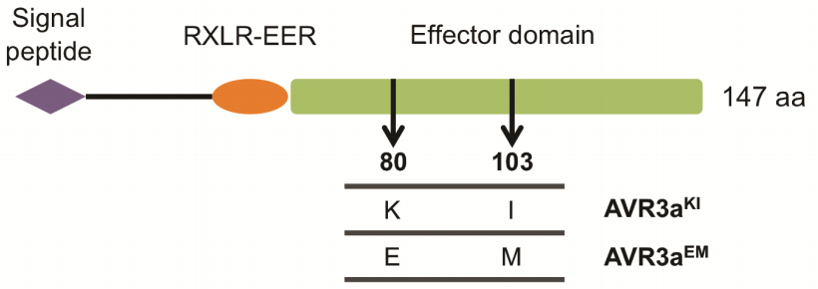
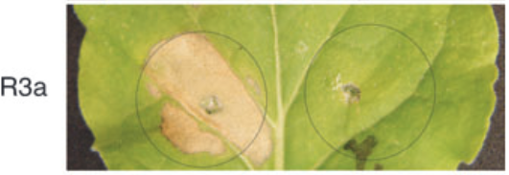
Locus: position in a genome where one or more alleles are segregating
Gene: Coding region of the genome
Allele: It is a variant form of a gene
Avr3a^{KI} triggers hypersensitive response but not Avr3a^{EM}
Isoforms of Avr3a
Avr3a^{KI} Avr3a^{EM}
Bos et al. 2006, The Plant Journal

Slide 10
Genotype: Genotype is the combination of the alleles at a particular locus.
If an individual has same allele at a locus, we call that homozyogous individual e.g AA or aa If an individual has different allele at a locus, we call that heterozygous individual e.g Aa
Genotype frequency: Number of individuals of certain genotype divided by total number of individuals.
Allele frequency: Frequency of copies of the allele in the population divided by total number of gene copies in the population.

Slide 11
Problem number 1:
Lets look at a locus that carries two alleles, A and B. In diploids, we would observed three possible genotypes, two homozygous (AA and BB), and one heterozygous (AB).
Lets say we found following genotype count,
AA = 38, AB = 16, BB = 46.
Calculate genotype frequency and allele frequency
Solution
AA genotype freq = AA/total number of individuals
AB genotype freq = AB/total number of individuals
BB genotype freq = BB/total number of individuals

Slide 12
Next we ll calculate allele frequency
Definition: allele freq is frequency of copies of the allele in the population divided by total number of gene copies in the population
A = 2*38 + 16
B = 2*46 + 16
Gene copies = 200
Allele freq A = A/gene copies
Allele freq B = B/gene copies
OR
A = Homozygotes freq + half of heterozygote freq
B = 1- A

Slide 13
Calculate genotype and allele frequencies
AA = 20
Aa = 30
aa = 40
MM = 45
Mm = 55
mm = 0

Slide 14
Hardy Weinberg equilibrium
Go to this link
https://shankarkshakya.github.io/geppopgen/HWE.html
Random mating

Slide 15
Test if the population is in HWE
AA = 245
Aa = 210
aa = 45
Steps:
Calculate genotype frequency (observed genotype frequency)
Calculate allele frequency
Calculate expected genotype frequency under HWE

Slide 16
AA = 245 = 245/500 = 0.49
Aa = 210 = 210/500 = 0.42 OBSERVED
aa = 45 = 45/ 500 = 0.09
Freq of allele A = 0.49+ 0.21 = 0.7
Freq of a = 0.3
Genotype freq under HWE
AA = 0.7 * 0.7 = 0.49
Aa = 2*0.3*0.7 = 0.42
aa = 0.3 *0.3 = 0.09

Slide 17
Problem : Test if the population is in HWE
AA = 400
Aa = 200
aa = 400

Slide 18
Break
After break we ll talk about
Why population in nature do not meet HWE?
Consequence of population not being in HWE
Population structure and how do we quantify it?
Visualize population structure (Clustering, NJ tree, DAPC)

Slide 19
Population structure and Fst
Random mating is rarely observed in nature.
Individuals that are close together are likely to mate with each other than distantly located individuals.
Because of this non random mating, we ll see population subdivision or also known as population structure.
One of the primary reasons we get population structure is geographic barrier like huge water bodies or high mountains.

Slide 20
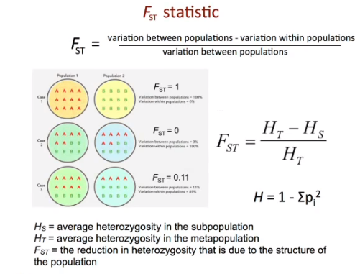

Slide 21
Fst
Fst ranges from 0 to 1
0: no allele frequency differences
0 < Fst < 1: some allele frequency difference
1: fixed difference between populations or no allele overlap
Fst = HWE predicted heterozygosity – observed heterozygosity
HWE predicted heterozygosity

Slide 22
Population 1
AA = 100
Aa = 0
aa = 0
Population 2
AA = 0
Aa = 0
aa = 100
Question: how much variation is between these populations?

Slide 23
Population 1
AA = 100
Aa = 0
Aa = 0
Population 2
AA = 0
Aa = 0
Aa = 100
Steps to calculate Fst:
Calculate genotype freq for pooled population
Calculate allele freq from genotype freq
Estimate heterozygosity under HWE

Slide 24
Population 1
AA = 100
Aa = 0
aa = 0
Population 2
AA = 0
Aa = 0
aa = 100
Steps to calculate Fst:
Calculate genotype freq for pooled population
AA = 100, Aa = 0 , aa = 100
GT freq = 0.5, 0, 0.5
Calculate allele freq from genotype freq
P(a) = 0.5, p(A) = 0.5
Estimate heterozygosity under HWE = 2*0.5*0.5 = 0.5
Fst = 0.5 – 0 /0.5 = 1

Slide 25
Now its your turn
Population 1
AA = 250
Aa = 500
aa = 250
Population 2
AA = 490
Aa = 420
aa = 90
Ans = 0.042
Population 1: AA = 20, Aa = 20, aa = 20
Population 2: AA = 15, Aa = 15, aa = 30
Ans: 0.016

Slide 26
Non random mating results in population structure
You can think population structure as clusters, so our next aim is to identify and visualize these clusters
Additional link
https://grunwaldlab.github.io/Population_Genetics_in_R/Pop_Structure.html

Slide 27
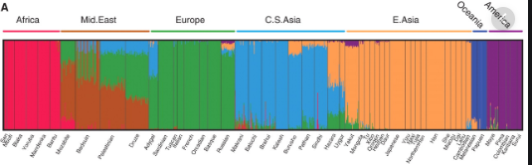
Structure plot

Slide 28
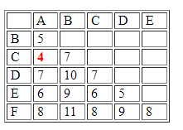
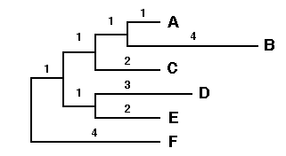
Phylogenetic tree : Neighbor joining tree
Visualization of population structure in a tree from based on distance matrix

Slide 29
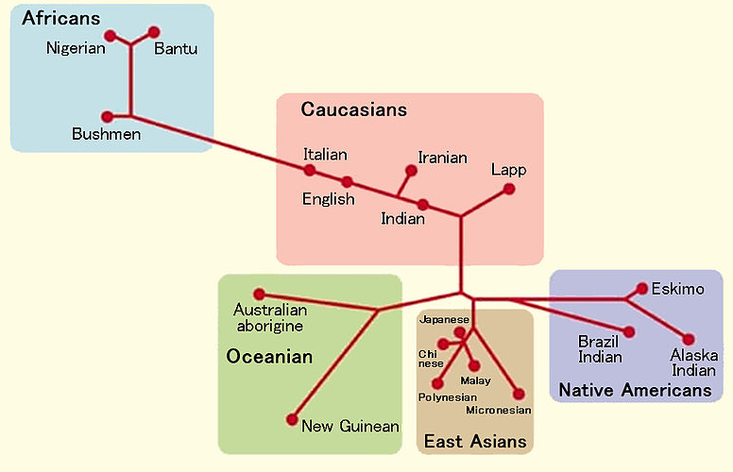
Phylogenetic tree : Neighbor joining tree

Slide 30
Distance between cities of Nepal
mydata<- read.csv("./npl-travel-distances-in-km-unrchc.csv", header = T, row.names = 1)
head(mydata)
mydistance <- dist(mydata)
head(mydistance)
library(ape)
#plot(nj(mydistance))
tree <- nj(mydistance)
tiff("ktmdistance.tiff", width = 7, height = 12, compression = "zip", res = 300, units = "in")
plot(root(tree, "Baitadi"))
dev.off()

Slide 31
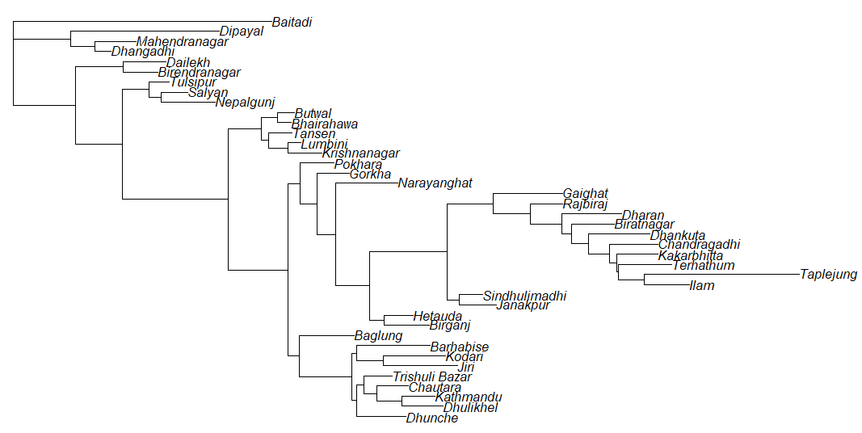

Slide 32
Discriminant analysis of principal components (DAPC)
.
.
.
.
.
.
.
.
.
.
.
.
.
.
.
.
.

Slide 33
Discriminant analysis of principal components (DAPC)
.
.
.
.
.
.
.
.
.
.
.

Slide 34
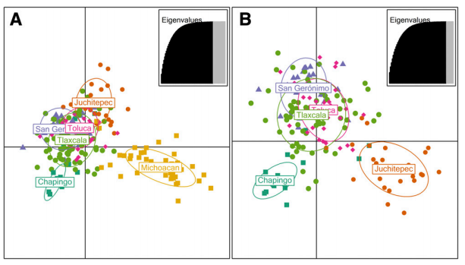
Discriminant analysis of principal components (DAPC)

Slide 35
Molecular markers

Slide 36
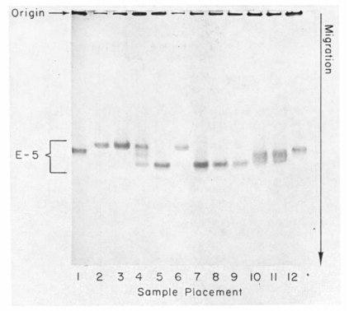
Measure of genetic variation
A molecular approach to the study of genic heterozygosity in natural populations. I. The number of alleles at different loci in Drosophila pseudoobscura.
J. L. Hubby and R. C. Lewontin
Genetics, 1966
Allozyme electrophoresis

Slide 37
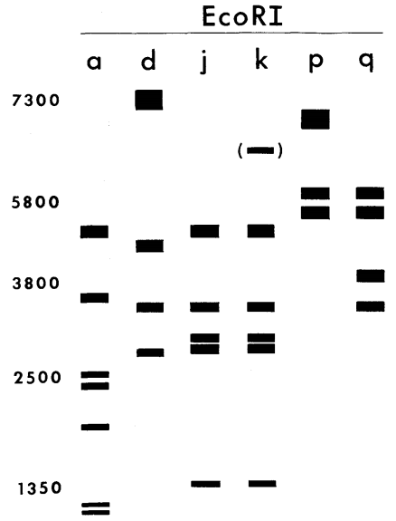
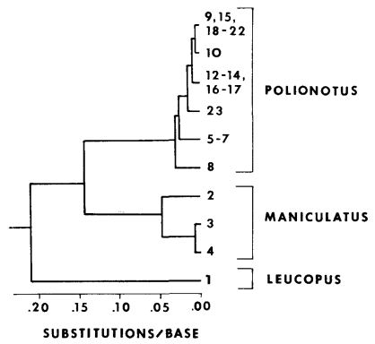
Measure of genetic variation
Restriction enzyme analysis
mt DNA tree
Avise et al. 1979, Genetics

Slide 38
Measure of genetic variation
Microsatellites/SSRs: regions of the genome with repeating sequences of two to six base pairs.
e.g. GTAGTAGTAGTAGTA (tri nucleotide repeat)
Advantage:
Highly polymorphic and easily genotyped.

